Slide 1


WORLD DATA LAB HACKATHON
UNLEASHING THE POTENTIAL OF YOUTH EMPLOYMENT DATA IN KENYA’S IT SECTOR

Slide 2

Name:
Lubanga Derrick
Research Scholar @iLabAfrica.
Get more exposure.
Put my skills into practice
Get to find places to improve
My goal is to employ my data science expertise as a force for positive change in addressing world problems.

Slide 3
METHODOLOGY
Process and Techniques:
Data Wrangling; data cleansing and integration.
Conducted exploratory data analysis (EDA) to gain insights into the datasets.
Technologies used:
Python: utilized the Python programming language for all the code examples and data analysis tasks.
Power Bi: Utilized power bi to show advanced visualizations dashboards.
Techniques and Visualizations:
Time Series Plot: We visualized trends over time by connecting data points with straight lines.
Heatmap: We used a heatmap to show the Pearson correlation coefficients between numeric columns in a color-coded matrix.

Slide 4
Data selection and processing
Variables: total_inactive_population, ILO_unemployed_rate, total_unemployed_population,total_employed_population,age_group,population
Data Reading and Overview:
Checked the basic information of the DataFrames using head(), info(), and describe() to get a sense of the data.
Handling Null Values: identified null values in the education DataFrame using isnull().sum() and checked the percentage of null values in each column.
Outlier Detection: You used box plots to visualize potential outliers in selected columns related to population and employment.
Visualization: Used various visualization techniques such as line plots, heatmaps, violin plots, and histograms to explore and present different aspects of the data.
Statistical Analysis: Computed mean and median values for relevant columns to understand central tendencies in the data.
Correlation Analysis: Calculated Pearson correlation coefficients between columns in the population DataFrame to analyze relationships and dependencies.
10K+
1K+
75K
Advertising
Production
Others Thing

Slide 5
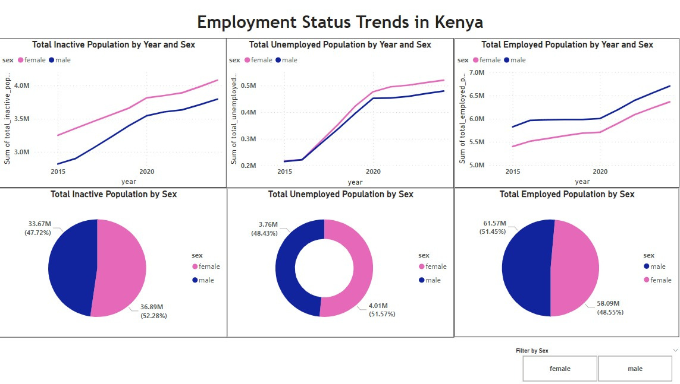

Slide 6
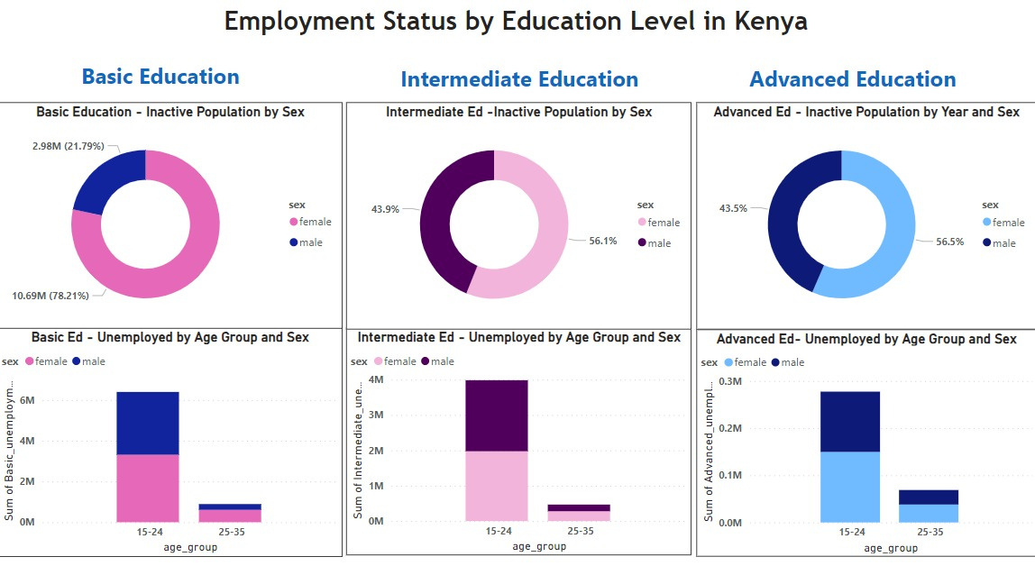

Slide 7
Findings/Insights
Through line plots and area plots, I observed the trends in employment, unemployment, and inactivity over the years. This helped in identifying periods of fluctuations and potential patterns in the job market.
Education and Employment Correlation; a strong positive correlation between higher education levels and employment rates, this could indicate that investing in education is essential for improving job prospects. Policymakers and educators can focus on initiatives that enhance educational opportunities and skills development.
The trends between gender, employment, inactivity and unemployment; males lead in employment over the years, females lead in unemployment and contribute to large percentage of inactive population.
The relation between education and employment; shows that females who are inactive and have education are high in numbers compared to the males, while the unemployment it seems balanced.

Slide 8
Recommendation/gaps/potential impact
Targeted Education Interventions: Focus on improving education and training programs for specific age groups and education levels that show higher unemployment rates.
Support for Vulnerable Groups: Implement policies that provide targeted support to vulnerable groups, such as young adults (15-24) and individuals with lower education levels.
Workforce Planning: Businesses should consider aligning their recruitment strategies with the available data on education levels and employment rates.
Collaboration with Educational Institutions: Collaborate with educational institutions to bridge the gap between required skills and those offered by education. This can lead to a more job-ready workforce.
Impact: Improved Workforce Planning: Businesses can make better hiring decisions and align their workforce needs with market realities, leading to increased operational efficiency.
Project's data-driven insights, recommendations, and potential impact hold the promise of contributing to meaningful improvements in employment outcomes.

Slide 9
THANK YOU
For Your Attention

